Slide 1
Automating Performance …
Joe Chang
SolidQ jchang@solidq.com
jchang6@yahoo.com
www.qdpma.com

Slide 2
About Joe
SQL Server consultant since 1999
Query Optimizer execution plan cost formulas (2002)
True cost structure of SQL execution plan operations (2003?)
Database with distribution statistics only, no data (2004?)
Decoding statblob/stats_stream – writing your own statistics
Disk IO cost structure
Tools for system monitoring, execution plan analysis etc

Slide 3
Overview
Why is performance still important today
Brute force?
Performance Tuning Elements
Automating Performance data collection & analysis
What can be automated
What still needs to be done by you!
SQL Server Engine
What every Developer/DBA needs to known

Slide 4
Performance – Past, Present and ?
Past – some day, servers will be so powerful that we don’t
have to worry about performance (and that annoying consultant)
Today we have powerful servers – 10-100X overkill*
32-40 cores, each 10X over Pentium II 400MHz
1TB memory (64 x 16GB DIMMs, $400 each)
Essentially unlimited IOPS, bandwidth 10+GB/s
(Unless the SAN vendor configured your storage system)
What can go wrong?
* Except for VM

Slide 5
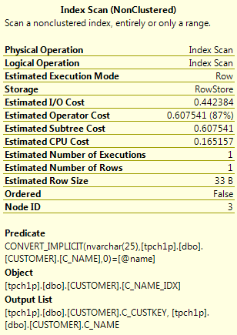
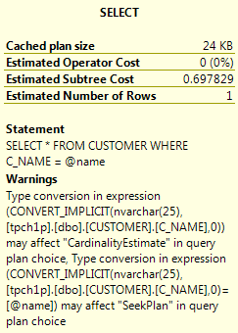
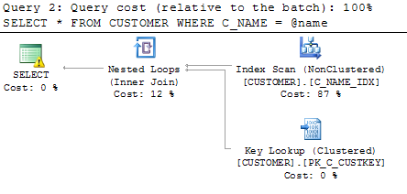
Ex 1 Parameter – column type mismatch
DECLARE @name nvarchar(25) = N'Customer#000002760'
SELECT * FROM CUSTOMER WHERE C_NAME = @name
SELECT * FROM CUSTOMER WHERE C_NAME = CONVERT(varchar, @name)
.NET auto-parameter discovery?

Slide 6
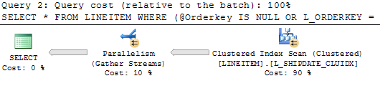
Example 2 – Multi-optional SARG
DECLARE @Orderkey int, @Partkey int = 1
SELECT * FROM LINEITEM
WHERE (@Orderkey IS NULL OR L_ORDERKEY = @Orderkey)
AND (@Partkey IS NULL OR L_PARTKEY = @Partkey)
AND (@PartKey IS NOT NULL OR @OrderKey IS NOT NULL)

Slide 7
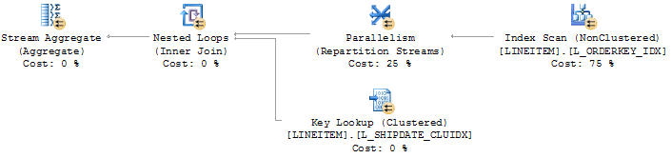
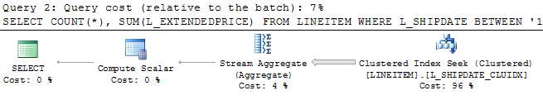
Example 3 – Function on column, SARG
SELECT COUNT(*), SUM(L_EXTENDEDPRICE) FROM LINEITEM
WHERE YEAR(L_SHIPDATE) = 1995 AND MONTH(L_SHIPDATE) = 1
SELECT COUNT(*), SUM(L_EXTENDEDPRICE) FROM LINEITEM
WHERE L_SHIPDATE BETWEEN '1995-01-01' AND '1995-01-31'

Slide 8
Ex 3 alternate date range
DECLARE @Startdate date, @Days int = 1
SELECT COUNT(*), SUM(L_EXTENDEDPRICE) FROM LINEITEM
WHERE L_SHIPDATE BETWEEN @Startdate AND DATEADD(dd,1,@Startdate)

Slide 9
Example 4 – Parameter sniffing
-- first call, procedure compiles with these parameters
exec p_Report @startdate = '2011-01-01', @enddate = '2011-12-31'
-- subsequent calls, procedure executes with original plan
exec p_Report @startdate = '2012-01-01', @enddate = '2012-01-07'
Need different execution plans for narrow and wide range
Options:
1) WITH RECOMPILE
2) main procedure calls 1 of 2 identical sub-procedures
One sub-procedure is only called for narrow range
Other called for wide range

Slide 10
Summary of serious problems
Parameter mismatch – parameter type over column
SQL search argument cannot be identified/optimized
Search argument: function (column)
Compile parameter & parameter range
Statistics anomalies
etc
Impact is easily 10-1000X or more

Slide 11
Performance Data Collection & Analysis
What data is important
What can be automated
What has not been automated successfully

Slide 12
Performance Data
Query Execution Statistics
Index Usage Statistics (Op stats, missing indexes)
Execution plans including compile parameters

Slide 13
Performance DMVs and DMFs
From SQL Server 2005 on
dm_exec_query_stats & related
dm_exec_sql_text,
dm_exec_text_query_plan & related (XML output)
dm_db_index_usage_stats & related
Table output is easy to collect and analyze
XML is not

Slide 14
Query Execution Statistics
Dm_exec_query_stats
Execution count, CPU, duration, Phy reads, Log Wr, Min/Max
Potentially 1M+ rows
Sorting can be expensive
Far fewer entries with total_worker_time > 1000 micro-sec
Find top SQL
Get execution plan, then work on it

Slide 15
Index DMVs
Index Usage Stats
Index level, usage stats but no waits
Index Operational Stats
Index & Partition level + wait stats
Index Physical Stats
Useful? But full index rebuilds can be quicker
Missing Index
Useful, but really need more info

Slide 16
Execution Plans - XML
Compile cost – cpu, time, memory
Indexes used, tables scanned
Seek predicates
Predicates
Compile parameter values
Saving XML plans from SSMS a pain?
Parsing XML from SQL is complicated and expensive

Slide 17
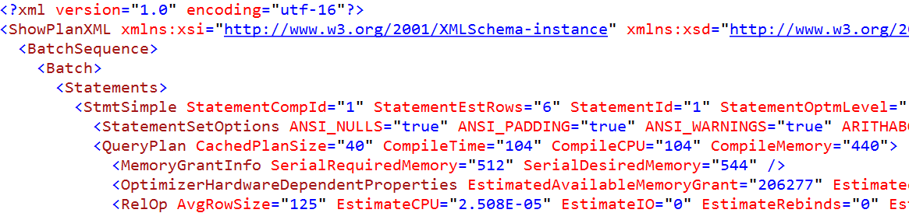
Compile versus Execute Time
Plan reuse desired if compile >> execute cost
Force recompile can be better if execute >> compile cost
And if parameters involve wide variation in number of rows

Slide 18
Full Execution Plan Analysis
Analyze execution plans for (almost) entire query stats
Or all stored procedures
Index used by SQL
What is implication of changing cluster key
Consolidate infrequently used indexes

Slide 19
Other Performance Data options
Generate estimated execution plans for all
stored procedures
Functions
Triggers?
Maintain a list of SQL to be executed with actual execution plans
Actual versus estimated row count, number of executions
Actual CPU & duration
Parallelism – distribution of rows
Triggers etc

Slide 21
Simple Performance Tuning
Find top SQL
Profiler/Trace
Query Execution Stats – sys.dm_exec_query_stat
Currently running SQL – sys.dm_exec_requests etc
Get SQL & Execution plan (DMF)
Rewrite SQL or re-index
Index usage statistics
Consolidate indexes with same leading keys
Drop unused indexes?
Index and Statistics maintenance
Blindly applying indexes from missing IX DMV not recommended
No automation required

Slide 22
Advanced Performance
What is minimum set of good indexes?
Can 2 Indexes with keys 1) ColA, ColB and 2) ColB, ColA be consolidated?
Infrequently used indexes – is it just for off-hours query?
What procedures/SQL uses each index?

Slide 23
Performance Problem Classification
Always bad
Performance slowly degrades over time
Probably related to fragmentation or unreclaimed space
Best test is if index rebuild significantly reduces space
Could be execution plan with scan, and size is growing
Sudden change: good to bad, bad to good
Probably compile parameter values or statistics

Slide 24
Maintaining Performance
Compile parameters
Data distribution statistics
update periodicity
Sample size
Indexes
Dead space bloat
Fragmentation less important?
Natural changes in data size & distribution

Slide 25
Performance Information
Query
Execution
Stats
Execution Plans
Index
Usage
Stats

Slide 27
The SQL Server Engine
Some important elements

Slide 28
What else can go wrong in a big way
Statistics
Sampling percentage, Accuracy, recompute, impact on plan recompile etc
AND/OR combinations
EXISTS/NOT EXISTS combinations
Complex SQL, sub-expressions
Row count estimation propagation errors
Parallel execution
Full-Text in complicated SQL

Slide 29
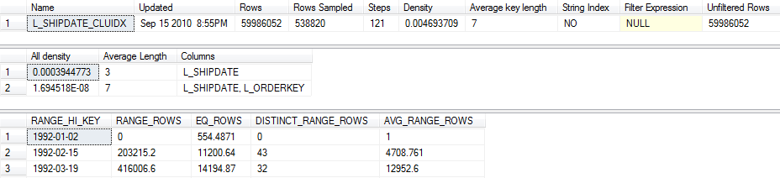
Statistics – SQL Server rules
Important to understand SQL Server statistics workings
When default polices and rules are effective and when not effective
Range_High_Key, Range_Rows, EQ_Rows, Distinct_RangeRows, Avg RR
Sampling – random pages, all rows in each page
percentage for reasonable accuracy based on true random row sample
Updates triggered at 6, 500, and every 20% modified
Statistics Used by the Query Optimizer in Microsoft SQL Server 2008
http://msdn.microsoft.com/en-us/library/dd535534(v=sql.100).aspx
Batch Compilation, Recompilation, and Plan Caching Issues in SQL Server 2005
http://technet.microsoft.com/library/Cc966425

Slide 30
Statistics - strategy
Sampling theory
for reasonable accuracy based on true random row sample
1/square root (N) – If 100 values are found, then accuracy is ±10
Actual sampling is random pages & all rows in page
Correlation between value and page?
Index statistics may benefit from FULLSCAN updates
What if compile parameter is outside boundary when stats were updated?
Potential serious errors if data distribution statistcs believes compile parameter value does not exist
Out of bounds or limited number of distinct values

Slide 31
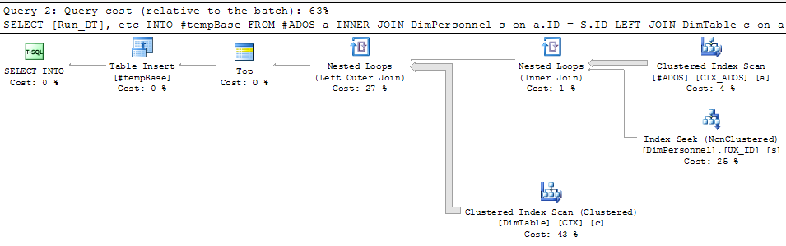
Seriously bad execution plan
Estimated out from first 2 tabes (at right) is zero or 1 rows. Most efficient join to third table (without index on join column) is a loop join with scan. If row count is 2 or more, then a fullscan is performed for each row from outer source
Default statistics rules may lead to serious ETL issues
Consider custom strategy

Slide 32
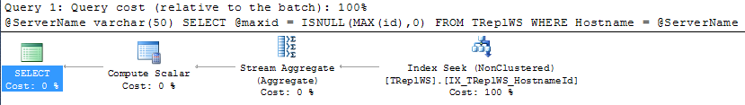
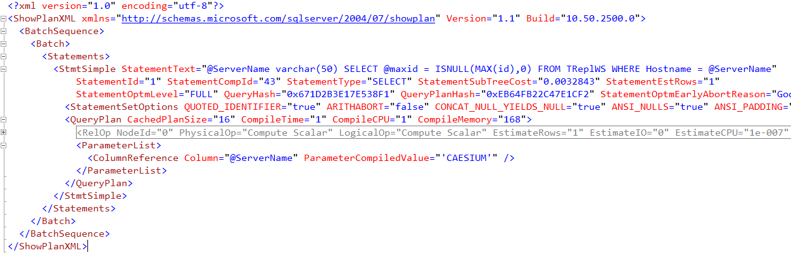
Plan Compile Parameters
Compile parameter values near bottom of XML

Slide 33
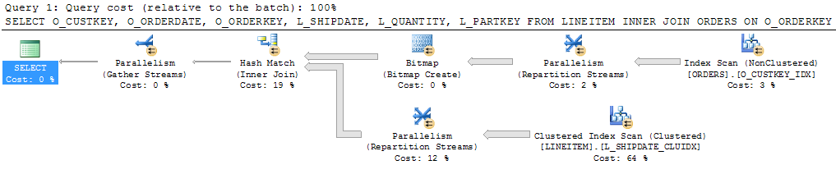
OR condition on different tables
SELECT O_CUSTKEY, O_ORDERDATE, O_ORDERKEY, L_SHIPDATE, L_QUANTITY, L_PARTKEY
FROM LINEITEM
INNER JOIN ORDERS ON O_ORDERKEY = L_ORDERKEY
WHERE L_PARTKEY = 184826
OR O_CUSTKEY = 137099

Slide 34
OR versus UNION
SELECT O_CUSTKEY, O_ORDERDATE, O_ORDERKEY, L_SHIPDATE, L_QUANTITY, L_PARTKEY
FROM LINEITEM INNER JOIN ORDERS ON O_ORDERKEY = L_ORDERKEY
WHERE L_PARTKEY = 184826
UNION -- ALL
SELECT O_CUSTKEY, O_ORDERDATE, O_ORDERKEY, L_SHIPDATE, L_QUANTITY, L_PARTKEY
FROM LINEITEM INNER JOIN ORDERS ON O_ORDERKEY = L_ORDERKEY
WHERE O_CUSTKEY = 137099
Above UNION SQL requires sort operation – cheap for few rows or narrow columns

Slide 35
Complex AND/OR, IN-NOT IN combinations
Hash Join is good method to process many rows
Requirement is equality join condition
In complex SQL with AND/OR or IN NOT IN combinations
Query optimizer may not be to determine that equality join condition exists
Execution plan will use loop join,
and attempt to force hash join will be rejected
Re-write using UNION in place of OR
And LEFT JOIN in place of NOT IN
SELECT xx FROM A WHERE col1 IN (expr1) AND col2 NOT IN (expr2)
SELECT xx FROM A WHERE (expr1) AND (expr2 OR expr3)

Slide 36
Complex SQL with sub-expressions
Compile cost – number of indexes, join types, join orders etc
Propagating row estimation errors
Splitting with temp table
Overhead of create table, insert
Reduced compile cost
Statistics recomputed for temp tables at 6 and 500 rows, and 20%

Slide 37
Parallel Execution Strategy
sys.configurations (sp_configure) defaults
Cost threshold for parallelism 5
Max degree of parallelism 0 (unlimited)
Problem – overhead for starting threads not considered
4 sockets, 10 cores each + HT => DOP 80 is possible
Concurrently executing parallel queries – contention issues
Option
Cost Threshold to 20-50
MaxDOP to 4 (for default queries)
Explicit OPTION (MAXDOP n) for known big queries
Concurrent parallel queries * DOP should be < total cores?

Slide 38
Full-Text + complex SQL
Examine execution plan of Full-Text queries
How many times is Full-Text search being evaluated?
i.e. as inner source of loop join
This is dues to a difficiency of SQL Server query optimizer cost model
May need to force hash join to FT or insert FT results into temp table if single search is preferable

Slide 39
Summary
Performance is still important
Automating performance data collection is easy
Why an execution plan may changed with serious consequences
Available tools cannot automate diagnosis of performance problems
This could be done?
Full SQL – index usage cross-reference
Optimized index set

Slide 40
Storage Performance
System level storage performance
Multiple RAID Controllers or HBAs – IO over multiple PCI-E slots
Multiple IO channels – IO over multiple SAS or FC links, no iSCSI!
Many disks on each IO channel
Number of disks(HDD or SSD) in each RAID group matched to IO channel
FC 8Gbits/s = 800MB, SAS x4 @ 6Gbits = 2.2GB/s net bandwidth
SQL Server IO
Query must generate even IO over all channels and to multiple disks in each file
Each key FileGroup must have 1 file on each RAID Group
-E startup parameter to allocated multiple extents per file
-T1117 for uniform file growth etc

